Slide 1
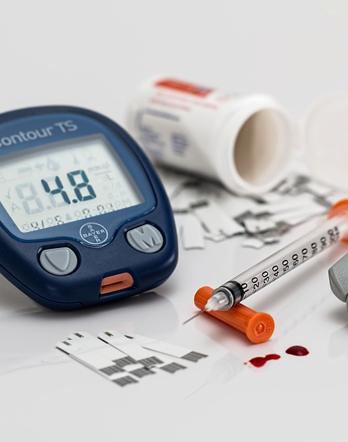

Predicting Diabetes in Patients
Dipika Sharma

Slide 2
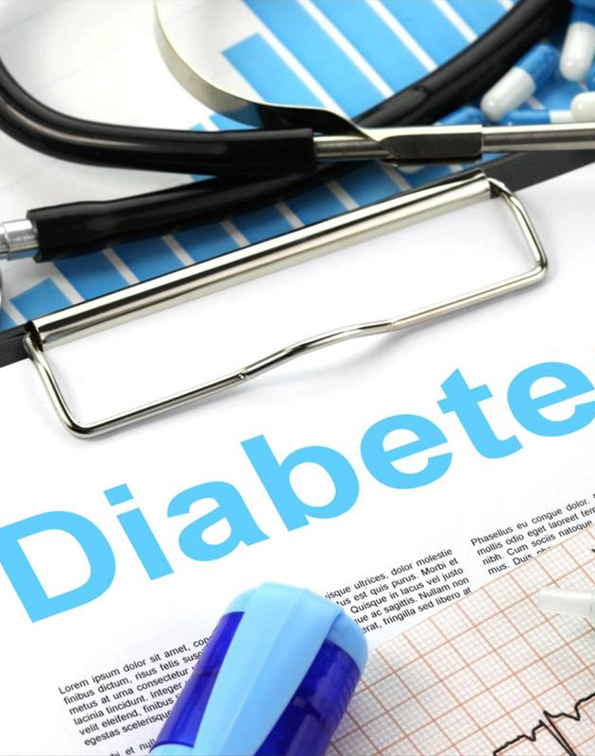
What is Diabetes?
Diabetes is a metabolic disease which can results in serious health issue if proper precaution not taken.
It causes high blood sugar which can affect the hormone insulin of patient body.
This Photo by Unknown Author is licensed under CC BY-SA
Notes:
Hormone insulin helps body in moving the sugar from the blood to body cells and make sure it stored as energy.

Slide 3

Goal
Diabetes is chronical disease.
Early identification of diabetes will give patient time to manage diet and use treatment to control it.
Reduce the risk of developing serious health problem.
This Photo by Unknown Author is licensed under CC BY-NC-ND
Notes:
Diabetes is chronical disease, and it is important to identify if patient has the diabetes as soon as possible.
As Early identification of diabetes will give patient time to manage diet and use treatment to control it and reduce the risk of developing serious health problem.

Slide 4
Dataset: Source
Kaggle Dataset
Data from National institutes of Diabetes, Digestive and kidney diseases.
Notes:
I used the dataset from Kaggle website, this dataset is from National institutes of Diabetes, Digestive and kidney diseases.

Slide 5
Dataset Features
9 Attributes:
Pregnancies : It is a numeric field to show number of times patient get pregnant
Glucose : Plasma glucose concentration 2 hours in an oral glucose tolerance test
BloodPressure : Diastolic blood pressure (mm Hg)
SkinThickness : Triceps skin fold thickness (mm)
Insulin : 2-Hour serum insulin (mu U/ml)
BMI : Body mass index (weight in kg/(height in m)^2)
DiabetesPedigreeFunction : Diabetes pedigree function
Age: Age (years) of the patient
Outcome : Class variable (0 or 1) 268 of 768 are 1, the others are 0
Notes:
This dataset seems to be good for our purpose as it consists of medical predictor variable like patient’s BMI, pregnancy details, insulin level, age, etc. and one target variable, outcome.

Slide 6
Data Understanding
768 rows with 9 features
Missing Values: The dataset have features with missing values, We’ll replace the zero values to NaN and then impute them with their mean or median value.
Scaling: Used Standard Scaling to normalize the train dataset.
Notes:
I started the analysis with cleaning process, where I learned that some of the columns have missing values which I planned to replace with the mean or median of the respective column. The missing values can impact the result accuracy and reliability hence it is very important to handle them carefully in preprocessing step.
The next important step before we start working on the model is scaling. Scaling is important as it avoid the biasness in model and improve the model accuracy. For our project we are using the standard scaling this will help us to normalize the train dataset to make sure all the features contribute at same level to the model and the model result will not get dominate by the larger values of single feature.

Slide 7
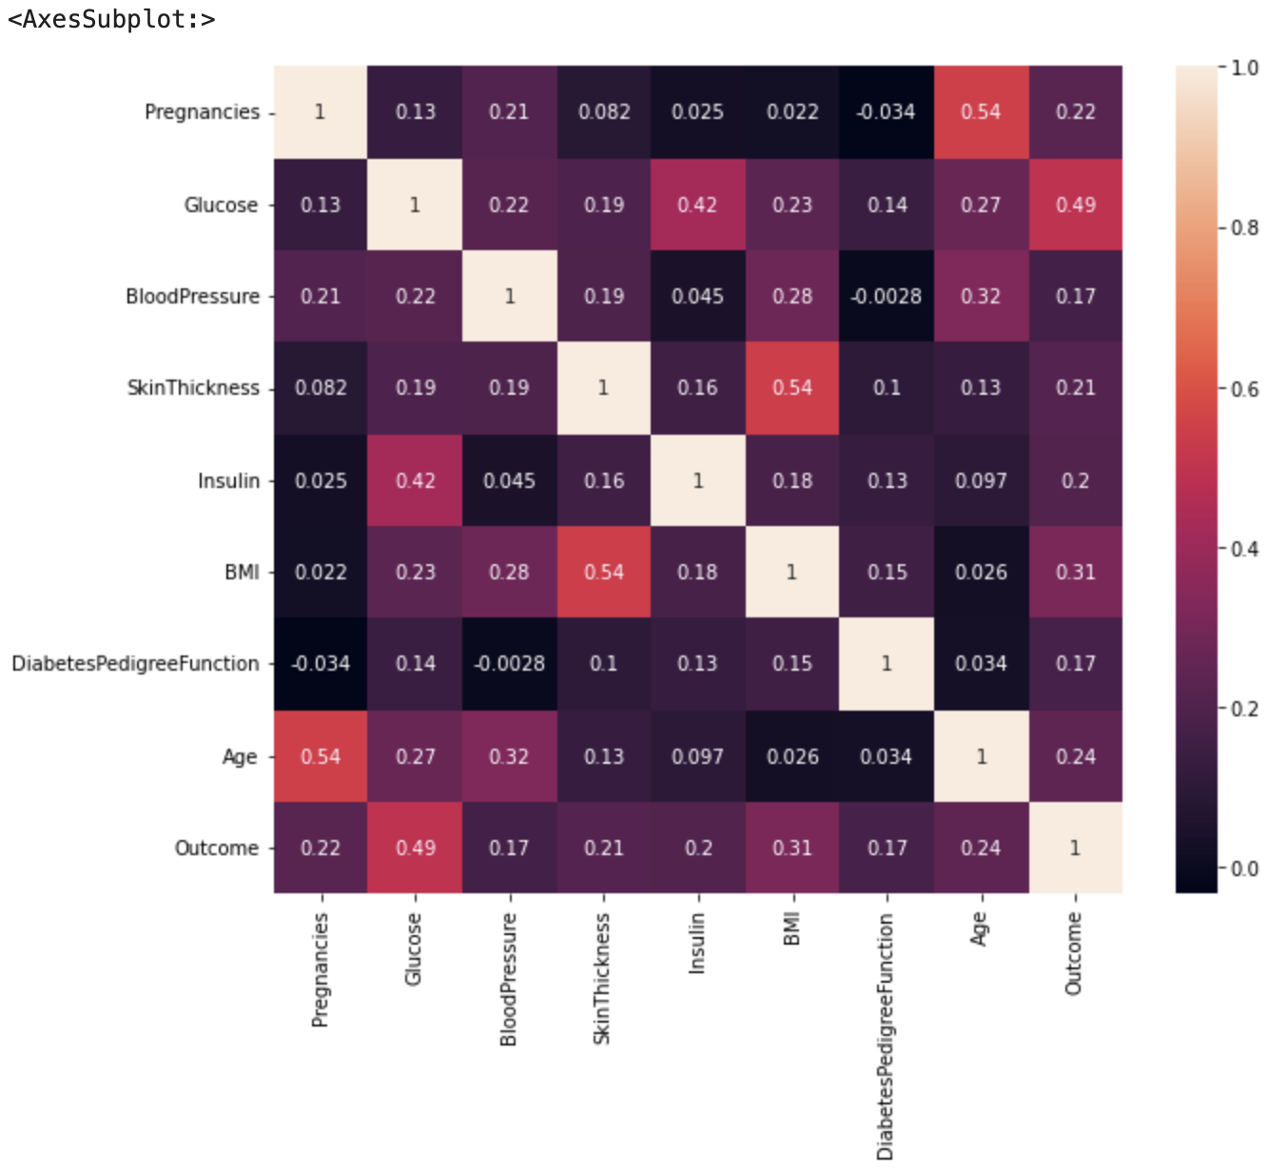
Correlation Matrix
Outcome is strongly related to glucose.
Show relations to features like BMI, Age, pregnancies, and skin thickness.
Notes:
Used the correlation Matrix to learn about the relationship between the dataset features
This heating map show that outcome is strongly related to glucose. Also, it is related to features like BMI, Age, pregnancies, and skin thickness.

Slide 8
Methodology: Algorithms
Random Forest
Decision Tree
Notes:
Used Random Forest and Decision Tree model for our project as they both considered to be the most widely used model when it comes to draw conclusions about a set of observation. These are appropriate models to deal with medical data and most widely known for efficiency, reliability, and capability when we need to perform predictive modeling.

Slide 9
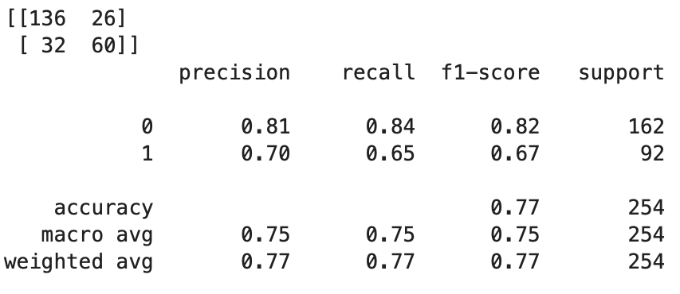
Methodology Results: Random Forest
Model Show accuracy of 77%
Precision is 70%
Recall is 65%
fi-score is 67%.
Notes:
after building the model I visualize the performance of the Random Forest model using the Confusion matrix, this matrix compare the predicted values to the actual labels of the dataset.
Random forest model show the accuracy of 77%
Precision is 70% which measure - how accurate a model’s positive predictions are
Recall is 65% this measures the effectiveness of a classification model in identifying all relevant instances from a dataset.
F1 score is 67% this is used to evaluate the overall performance of a classification model

Slide 10
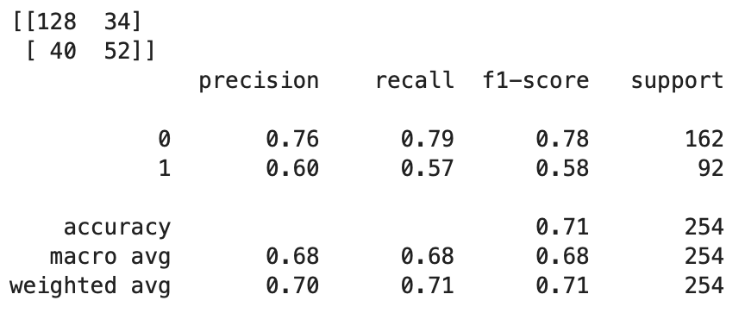
Methodology Results: Decision Tree
Model Show accuracy of 71%
Precision is 60%
Recall is 57%
fi-score is 58%.
Notes:
As next step I build the decision tree and evaluate the performance again using the confusion matrix and this model

Slide 11
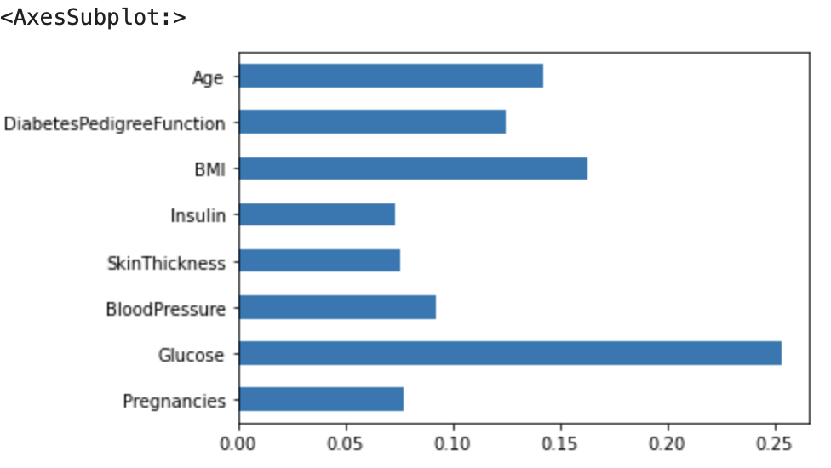
Features Importance
Glucose is an important feature which ca influence the prediction of the model.
Notes:
I also analyzed all the features to understand which features has more importance and can change the prediction. I Used the feature importances from the Random Forest and visualize the data to have clear understanding.
As we can see the graph shows that the glucose is an important feature which has most of the influence in predicting if patient has diabetes or not.

Slide 12
Conclusion
Confusion Matrix and classification report show built model is working.
Results are encouraging.
Random forest model show accuracy of 77% and came out as best model in this project scenario.
Further Research and Implementation
Notes:
The two-model decision tree and random forest were trained to performed prediction, but random forest show the accuracy of 77% and came out as best model in this project scenario.
It is important to detect the diabetes in patient early, delay in detection can cause complication to organs like heart and kidneys. With this project we are aiming to offer a machine learning tool which can predict diabetes with accuracy and precision. Using the Random Forest model will add value and help patient to take early precaution to be healthy.
The next step is to partner with heath organizations, share the importance of the machine learning model with them, get access to the patient data so the model can be tested more on real time patient data.
Once the testing is done, we can implement the model in hospital, urgent care and any other medical services where medical support is provided to patient and the predictor variable like glucose and other important information of patient can be obtained. Once the model has all the predictor variables, it can identify health risk and alert the providers to make preventive strategies to safe patient life or reduce risk. Regular checks can be done to make sure of the consistency of the model and flow of the data.

Slide 13
Sources:
World health Organization: - What is Diabetes? https://www.who.int/news-room/fact-sheets/detail/diabetes#:~:text=Diabetes%20is%20a%20chronic%20disease,hormone%20that%20regulates%20blood%20glucose.
Data Source : - https://www.kaggle.com/datasets/uciml/pima-indians-diabetes-database/data

